Slide 1
VTRIX TECHNOLOGY COMPANY LIMITED www.VTRIX.net 深圳里奇视讯电子有限公司 www.LYTCH.net
Hotline: +86-755-26076847 Email: hua.li@vtrix.net, hua.li@lytch.net Addr: 6th Floor, Building 1, LiHe Industrial Area, 1055 SongBai Road, Xili Town, Nanshan District, Shenzhen, China，518055

Slide 2
Introduction
Found in 2013
Focus: Video processing, Cross-point, long distance transmission
Products: Matrix, H265 AV over IP, Presentation Switcher
Professional ODM provider
Video processiong:
Switch, Split, Scaling, MultiViewer, VideoWall, H265
Long distance transmission
Fiber, SDI, HDbaseT, AV over IP
Distance: 30m~10Km

Slide 3
Technology Roadmap
Single Scaler
4K60 Seamless
Switching
H265
AV over IP
With new chipset
48G
Seamless
Switching
Video Processor
4K60
Seamless
Switching
H265
AV over IP
1080p
Seamlss
Switching
scaler
for mixed in/out matrix
2024
2022
2018
2013
2008

Slide 4
Products Roadmap
Q4K/Q18G/Q0ms
4K@60Hz
Modular Matrix
8x8~32x32
4K60 H265 AVIP
Q48G
2025
988VM
4K@60Hz
Modular
Matrix
8x8~140x140
H265 AVIP
VM88
2K 1080p
Modular
Matrix
8x8~
80x80
2025
Seamless
Switching
Multi
format
Cards
2023
2018
2016
2013
2008

Slide 5
Products
Q48G
Seamless
Switching
Matrix
Y2025
48G
Video Processor
Y2025
KVM18G
18Gbps
Seamless
USB2.0
Ethernet
Y2025
Performance
Q18G
18Gbps
Q0ms
0ms
Seamless
Switching
Q4K
Quad-Ch
Modular
Matrix
4K60
LCD/LED Video Processor
4 in
8/9/12/16 out
HS4K60
AVIP with
free-windows
HS4K30
AVIP with
free-windows
988VM
Dual-Ch
Modular
Matrix
SS4K30
AVIP

Slide 6
988VM, SS4K30: LCD Video Wall
988VM
Dual-Ch
Modular
Matrix
LCD Video Wall
HDMI
SS4K30
AV over IP
LCD Video Wall
HDMI

Slide 7
Q4K/Q18G/Q0ms, HS4K60: LCD/LED Video Wall
Q4K/Q18G/Q0ms
Quad-Ch
Modular Matrix
HS4K60
AV over IP
HDMI
LCD
Video Wall
Sender card
LED
Video Wall
Q4K/Q18G/Q0ms
Quad-Ch
Modular Matrix
HS4K60 AV over IP
4K60
LCD/LED Video Processor
4 in
8/9/12/16 out
HDMI
LCD
Video Wall
HDMI
Sender card
LED
Video Wall

Slide 8
Matrix, AV over IP, Video Processor
Q4K/Q18G/Q0ms
Visual Controller
IP Decoder IP Encoder
4K60
LCD/LED Video Processor
4 in
8/9/12/16 out
HDMI
HDMI
LCD
Video Wall
RJ45
RJ45
Sender card
LED
Video Wall
AV over IP
HS4K60 / HS4K30
SS4K30
HDMI

Slide 9
核心技术
Core technology
No. | Item | Description
1 | Cross-point | up to 160x160, 6.5Gbps
2 | Seamless Switching | 2K HDMI 1.3, 4K HDMI 2.0
3 | 4K HDMI 2.0 scaler | Any resolution converts to 4K HDMI 2.0 4K HDMI 2.0 converts to lower resolution
4 | VideoWall | Matrix or standalone VideoWall processor.
5 | MultiViewer | Matrix or standalone MultiViewer.
6 | Fiber extender | Sing fiber, Sing mode. Up to 2~20Km
7 | HDbaseT extender | Tansmitter, receiver, daughter cards.

Slide 10

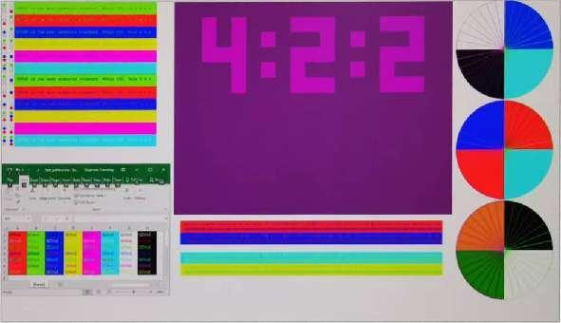
True 18Gbps, 444 color space, lossless
No only just support HDMI 2.0 18Gbps on In/Out
Input processing: 18Gbps, 4K 4:4:4@60Hz
Crosspoint: 18Gbps
Output processing: 18Gbps, 4K 4:4:4@60Hz
TV chips: convert to 4:2:2 for less band-width
FPGA solution: convert to 4:2:2 for less band-width

Slide 11
Q4K: Quad-Ch, 4K60, Seamless Switching Matrix
 | Q4K144 2025 | Q4K72722025 | Q4K3232 | Q4K1616 | Q4K0808
Size | 144x144 | 72x72 | 32x32 | 16x16 | 8x8
Housing | 20U | 10U | 5U | 3U | 2U
4K HDMI 2.0 | ☑ | ☑ | ☑ | ☑ | ☑
HDbaseT | ☑ | ☑ | 1.0 | 1.0 | 1.0
LCD Wall | ☑ | ☑ | ☑ | ☑ | ☑
LED Wall | ☑ | ☑ | ☑ | ☑ | ☑
Controller | ☑ | ☑ | ☑ | ☑ | ☑
Redundant power supply
LAN control (HTML): PC, Smartphone, PAD, etc. RS232 control
Daugter cards:
IP / Fiber / HDbaseT / SDI / HDMI / DVI / VGA / YPbPr / AV

Slide 12
Q18G: Quad-Ch, 18Gbps, Seamless Switching Matrix
 | Q18G144 2025 | Q18G7272 2025 | Q18G3232 | Q18G1616 | Q18G0808
Size | 144x144 | 72x72 | 32x32 | 16x16 | 8x8
Housing | 20U | 10U | 5U | 3U | 2U
18Gbps | ☑ | ☑ | ☑18Gbps | ☑18Gbps | ☑18Gbps
HDbaseT | 3.0 | 3.0 | HDbaseT3.0 | HDbaseT3.0 | HDbaseT3.0
Controller | ☑ | ☑ | ☑ | ☑ | ☑
Redundant power supply
LAN control (HTML): PC, Smartphone, PAD, etc. RS232 control
Daugter cards:
IP / Fiber / HDbaseT / SDI / HDMI / DVI / VGA / YPbPr / AV

Slide 13
Q0ms: Quad-Ch, 18Gbps, 0ms Seamless Matrix
 | Q0ms14472 2025 | Q0ms7236 2025 | Q0ms3216 | Q0ms1608 | Q0ms0804
Size | 144x72 | 72x36 | 32x16 | 16x8 | 8x4
Housing | 20U | 10U | 5U | 3U | 2U
18Gbps | ☑ 18Gbps | ☑ 18Gbps | ☑ 18Gbps | ☑ 18Gbps | ☑ 18Gbps
0ms | ☑ 0ms | ☑ 0ms | ☑ 0ms | ☑ 0ms | ☑ 0ms
HDbaseT | HDbaseT3.0 | HDbaseT3.0 | HDbaseT3.0 | HDbaseT3.0 | HDbaseT3.0
Controller | ☑ | ☑ | ☑ | ☑ | ☑
Redundant power supply
LAN control (HTML): PC, Smartphone, PAD, etc. RS232 control
Daugter cards:
IP / Fiber / HDbaseT / SDI / HDMI / DVI / VGA / YPbPr / AV

Slide 14
988: Dual-Ch Seamless Switching Modular Matrix
 | 9140VM | 980VM | 936VM | 916VM | 988VM
Size | 140x140 | 80x80 | 36x36 | 16x16 | 8x8
Housing | 29U | 16U | 8U | 4U | 2U
4K HDMI 2.0 |  | ☑ | ☑ | ☑ | ☑
Redundant power supply
LAN control (HTML): PC, Smartphone, PAD, etc.
RS232 control
Seamless Switching, video wall.
Daugter cards:
Fiber / HDbaseT / SDI / HDMI / DVI / VGA / YPbPr / AV

Slide 15
矩阵产品
4K60 HDMI 2.0 seamless matrix and video wall
 | VM18G88 VM4K88H3 | VM18G44H VM4K44H3 | VW4K29 | VW4K224
 | 8x8/4x4 matrix with video wall |  | 3x3/2x2 video wall
Size | 8x8 | 4x4 | 2x2x9 | 2x2x4
18Gbps | ☑ 18Gbps | ☑ 18Gbps | ☑ 18Gbps | 
0ms |  | ☑ 0ms |  | 
Inputs | HDMI+IR+L/R x 8 | HDMI+IR+L/R x 4 | HDMI x 2 | HDMI x 2
Outputs | HDMI+IR+L/R x 8 | HDMI+IR+L/R x 4 | HDMI x 9(VideoWall) HDMI x 2(bypass) | HDMI x 4(VideoWall) HDMI x 2(bypass)

Slide 16
4K60 HDMI2.0 presentation switcher with multiviewer
 | PS913 | KVM913
Inputs | 7xHDMI 2.0, 1xDP, 1xUSB-C (video only)
Outputs | 2xHDMI 2.0. 1xHDbaseT (444@60Hz@100m with DSC compression)
MultiViewer | Up to 4-windows
18Gbps | ☑ 18Gbps | ☑ 18Gbps
0ms | ☑ 0ms | ☑ 0ms
Microphone | ☑ | 
Volume control | ☑ | 
KVM |  | 8xUSB-B, 8xRS232
Mouse roaming |  | ☑

Slide 17
4K60 HDMI2.0 presentation switcher with multiviewer
 | PS512 | SWB41MV | SWB512MV
Inputs | 3xHDMI 2.0, 1xDP, 1xUSB-C (video only) | 4xHDMI2.0 | 4xHDMI 2.0, 1xUSB-C (video only)
Outputs | 1xHDMI 2.0. 1xHDbaseT (420@60Hz@40m) | 1xHDMI2.0 | 2xHDMI2.0
MultiViewer | Up to 4-windows
18Gbps | ☑ 18Gbps | ☑ 18Gbps | ☑ 18Gbps
0ms | ☑ 0ms | ☑ 0ms | ☑ 0ms
Mouse roaming |  |  | ☑

Slide 18
4K60 HDMI2.0 matrix with multiviewer
 | VM18G44MV (VM4K44MV)
 | 4x4 seamless switching matrix with video wall and multiviewer
Matrix | Same as VM4K44H2
VideoWall | 2x2 video wall with 90°/180° rotation
MultiViewer | Up to 4-windows
18Gbps | ☑ 18Gbps
0ms | ☑ 0ms
Audio | HDMI: Up to 7.1ch SPDIF: Up to 5.1ch L/R: input with PCM format
Independant | Each output works in independant mode as: Matrix mode, Video Wall mode, Multiviewer mode

Slide 19
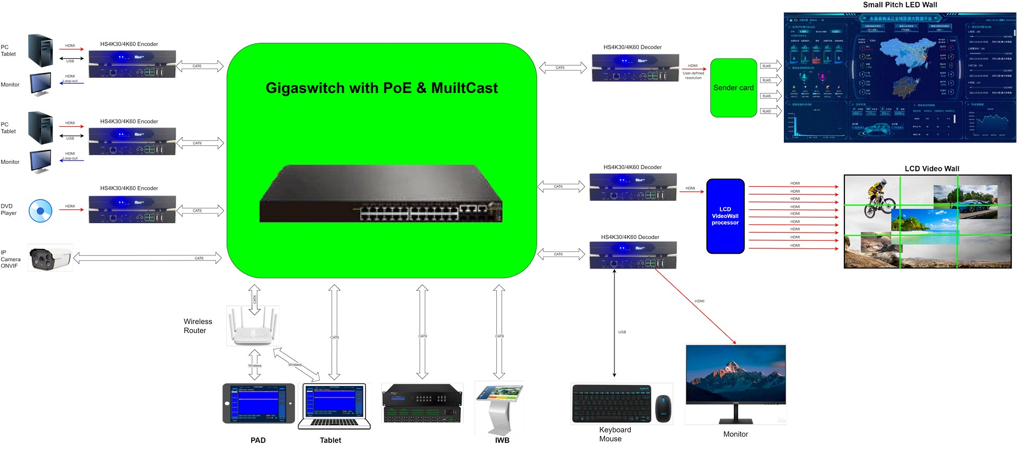
MVWP/MLP series: AV over IP (H265)

Slide 20


Thank you For more info, website: www.VTRIX.net www.LYTCH.net

Slide 21
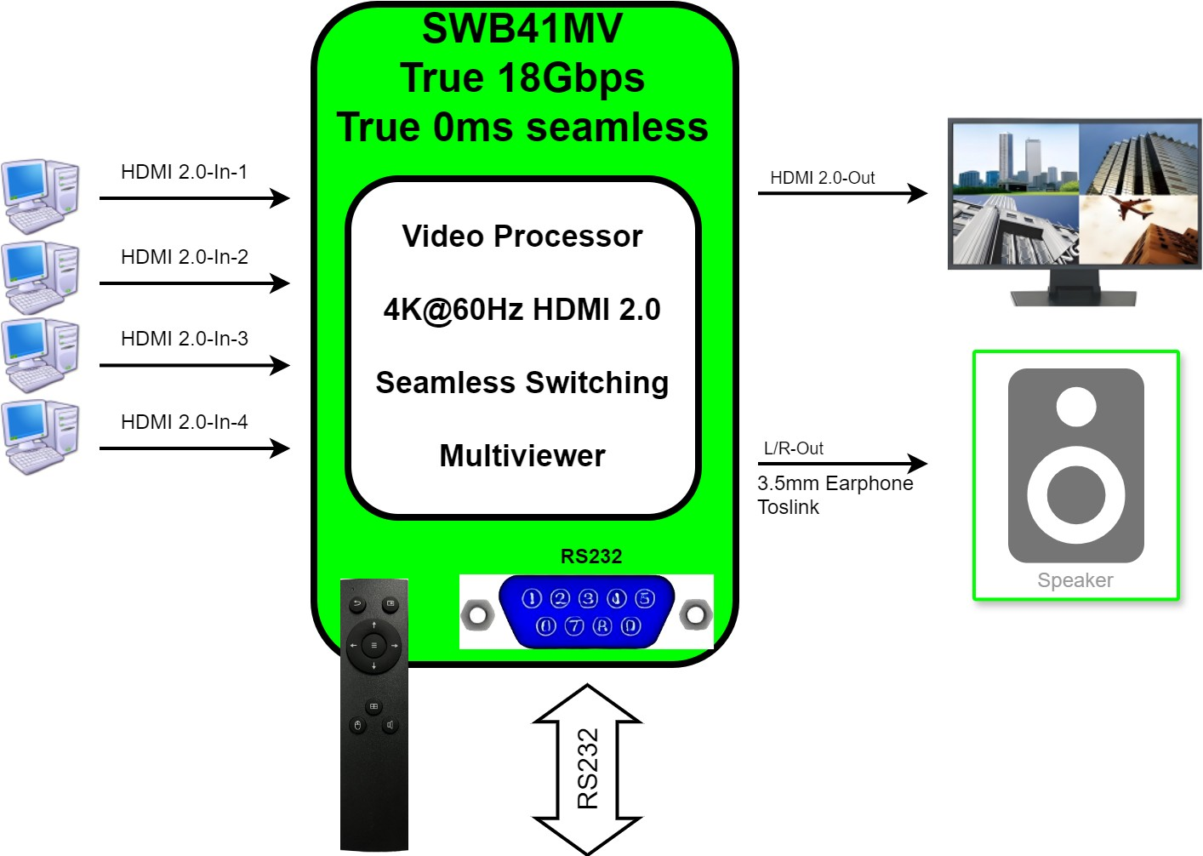
SWB41MV

Slide 22
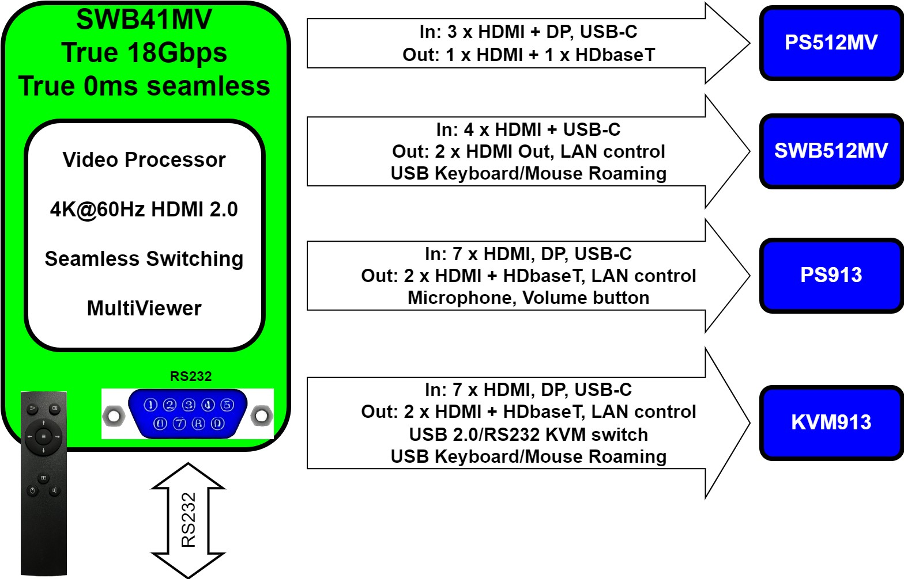
PS / SWB Selection Guide

Slide 23
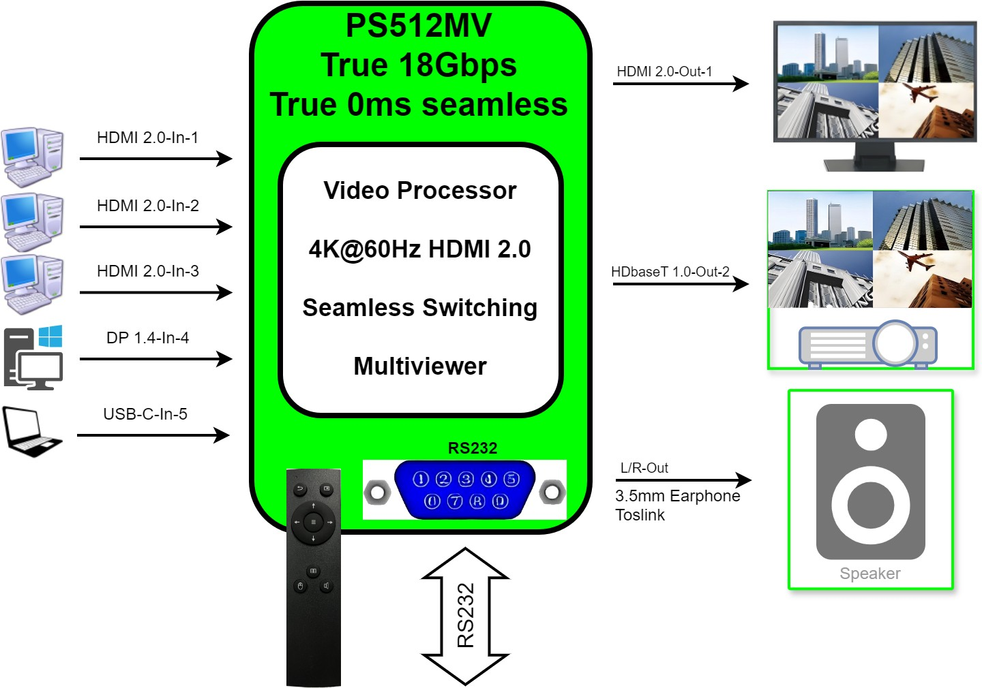
PS512MV

Slide 24
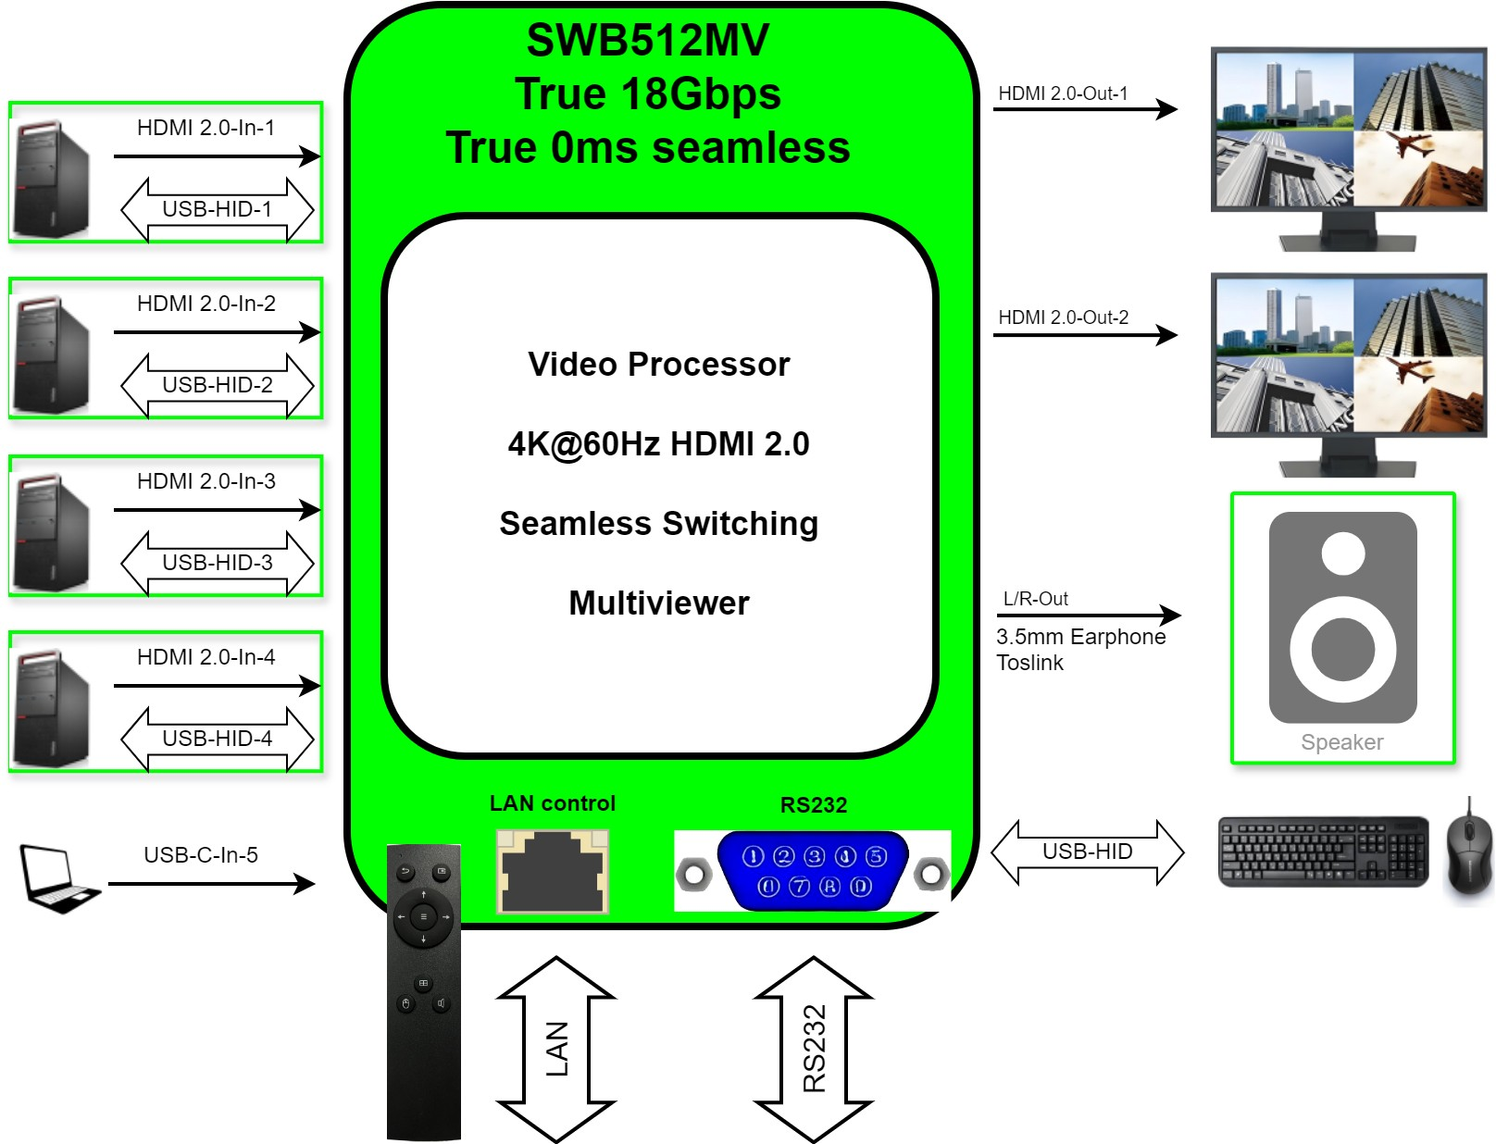
SWB512MV

Slide 25
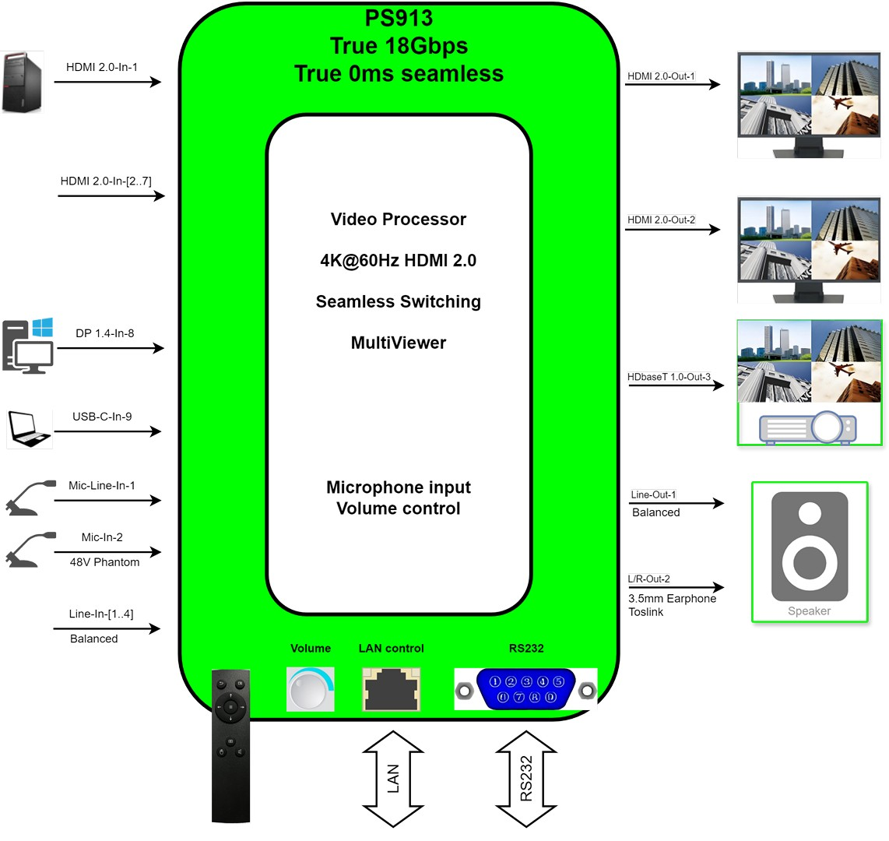
PS913

Slide 26
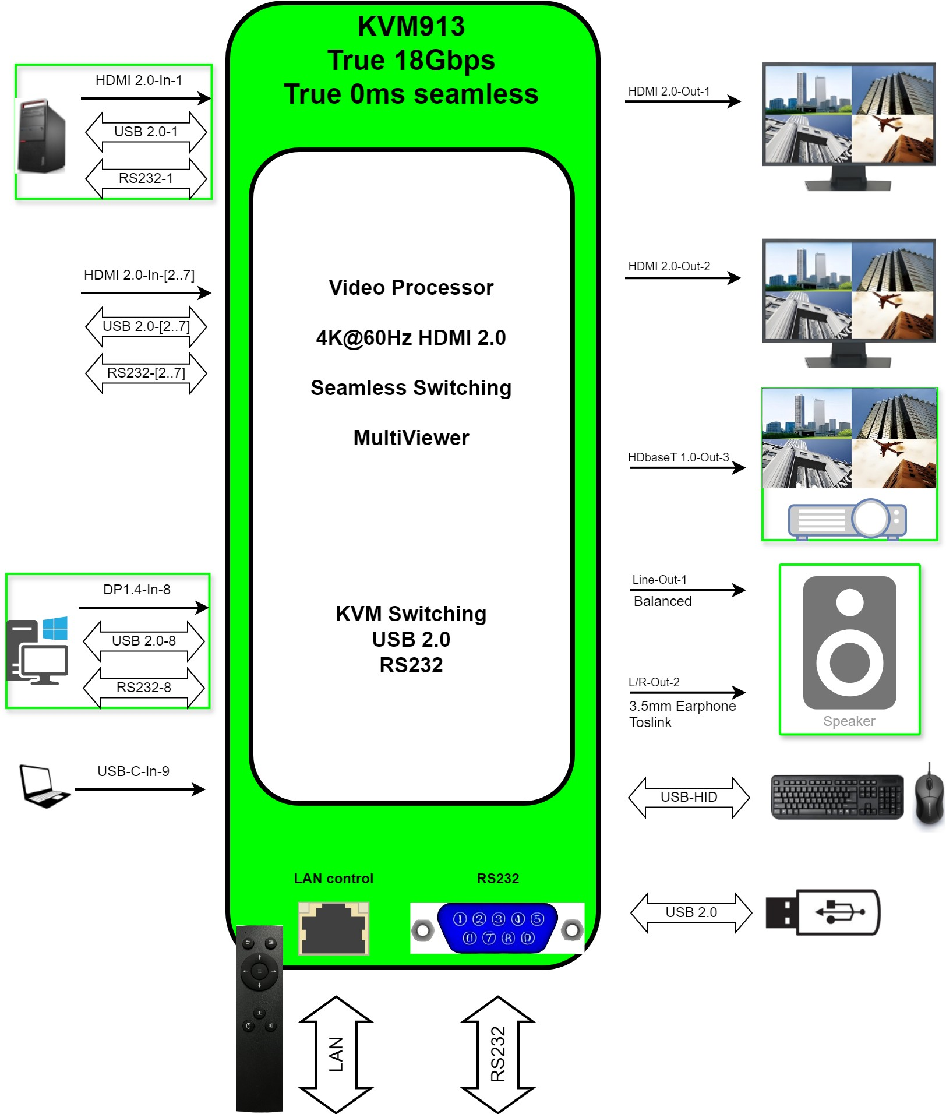
KVM913

Slide 27
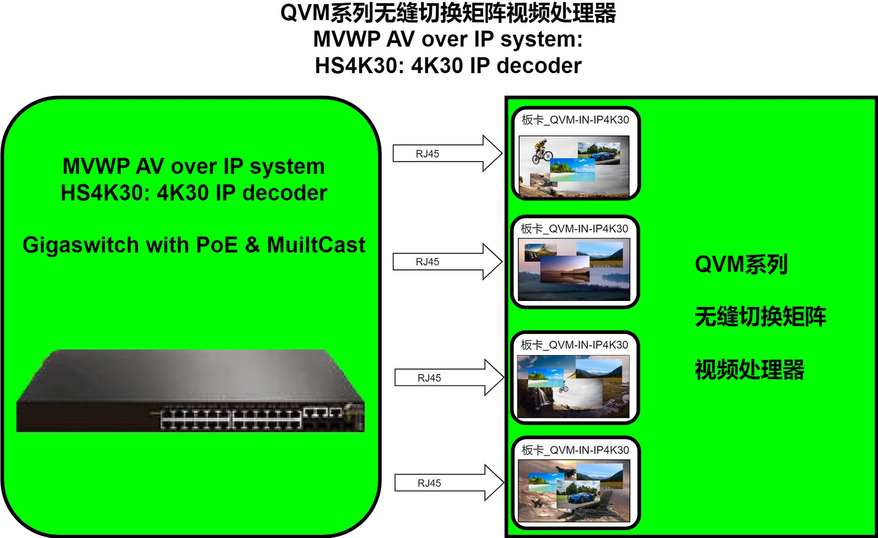

Slide 28
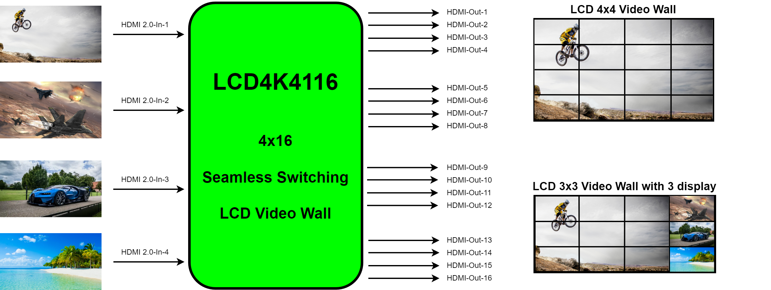
LCD Video Wall Processor, Aug 2024

Slide 29
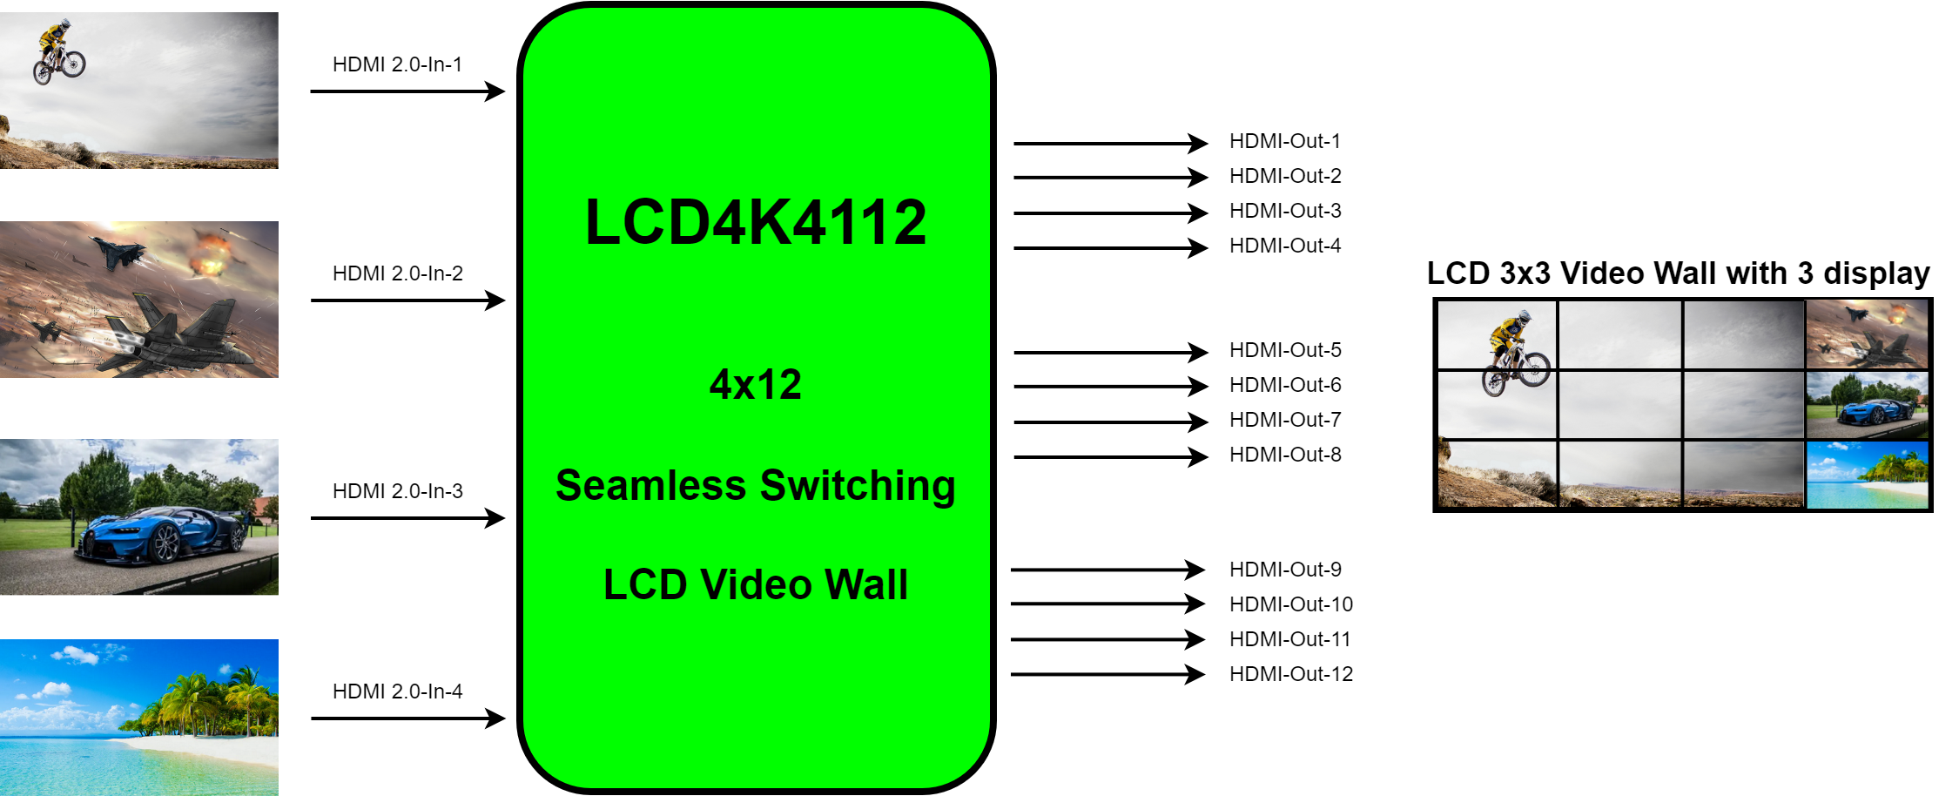
LCD Video Wall Processor, Aug 2024

Slide 30
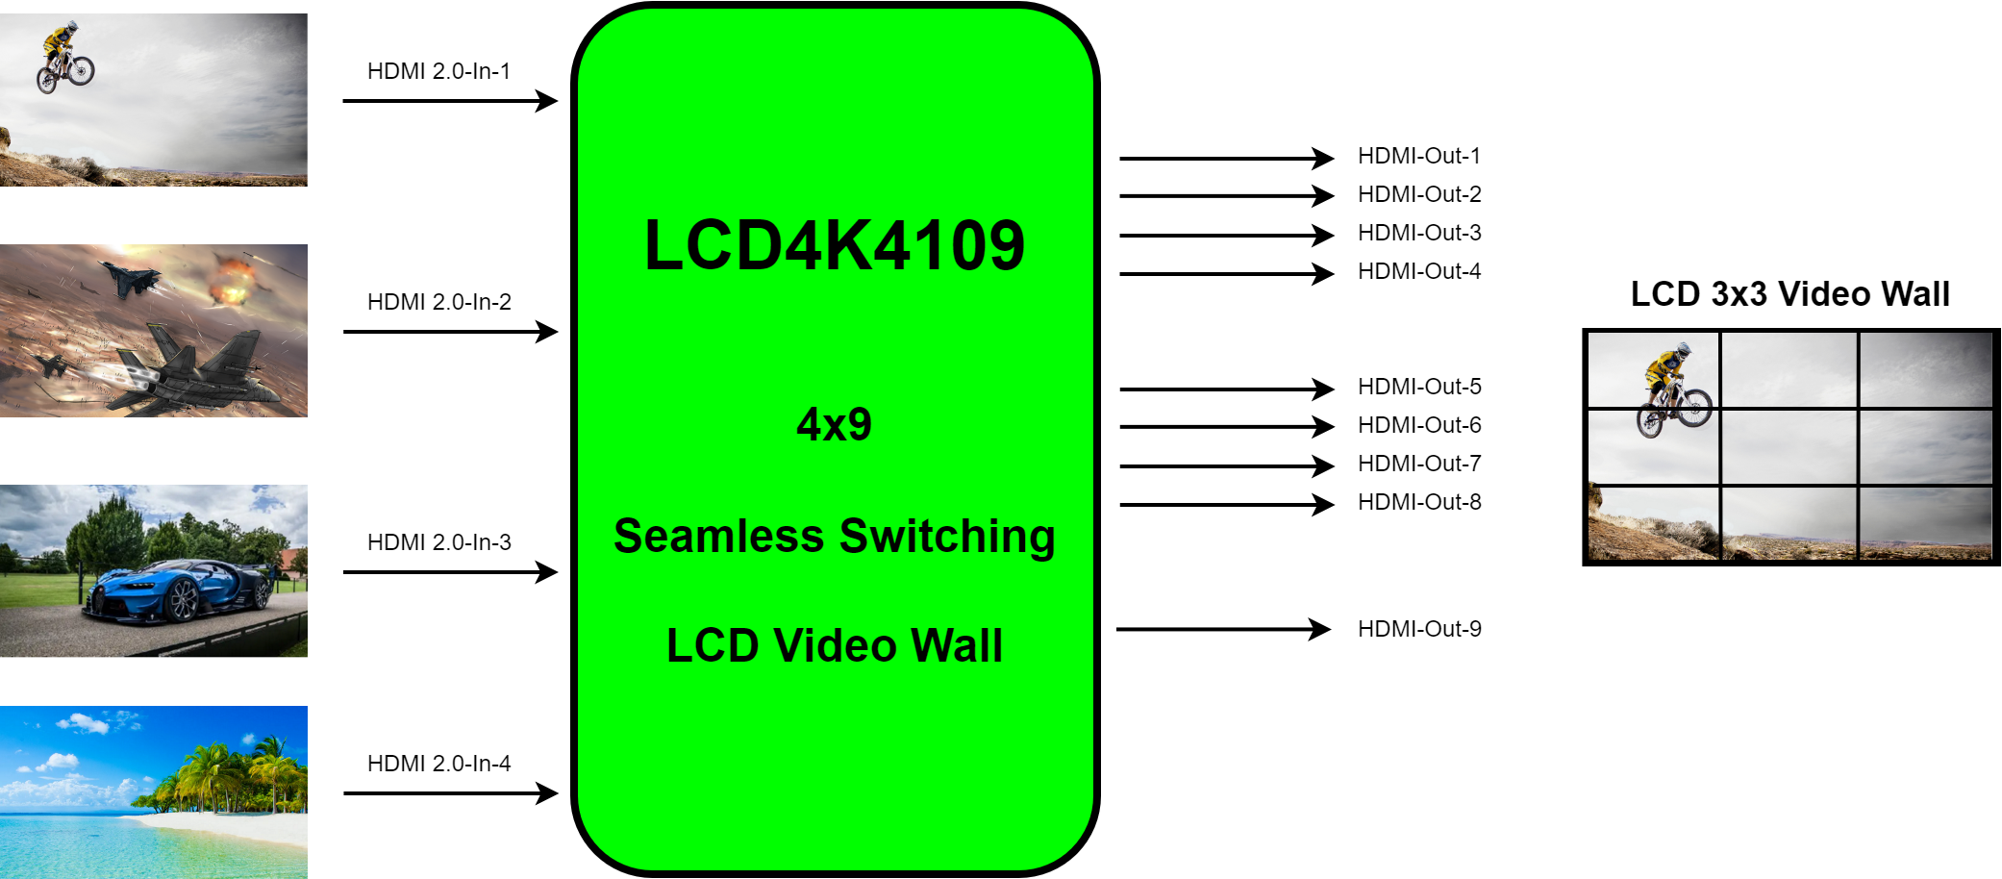
LCD Video Wall Processor, Aug 2024

Slide 31
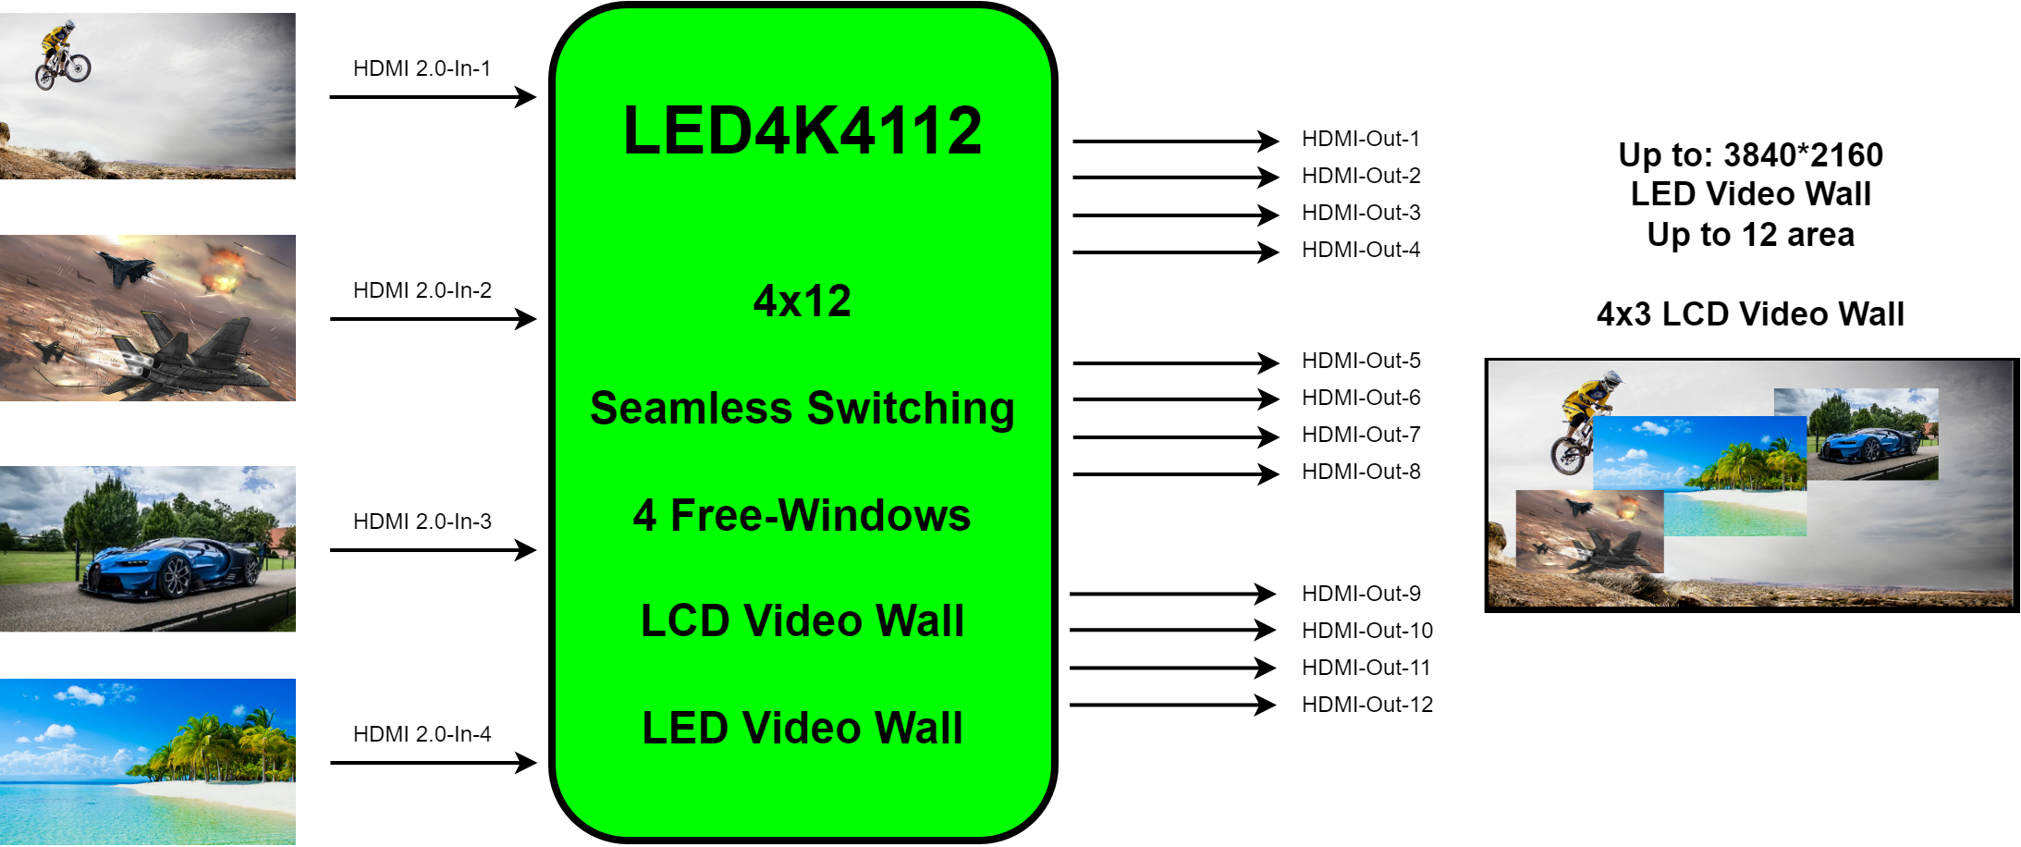
LED Video Processor, Aug 2024

Slide 32
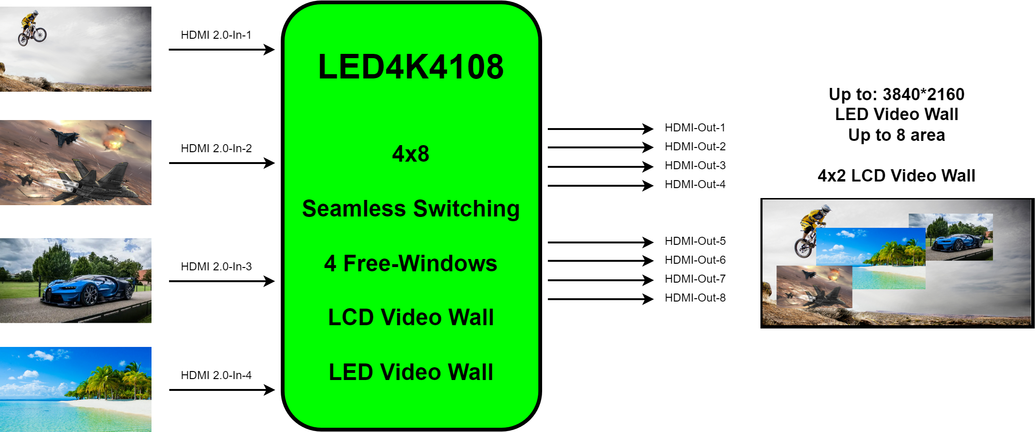
LED Video Processor, Aug 2024

Slide 33
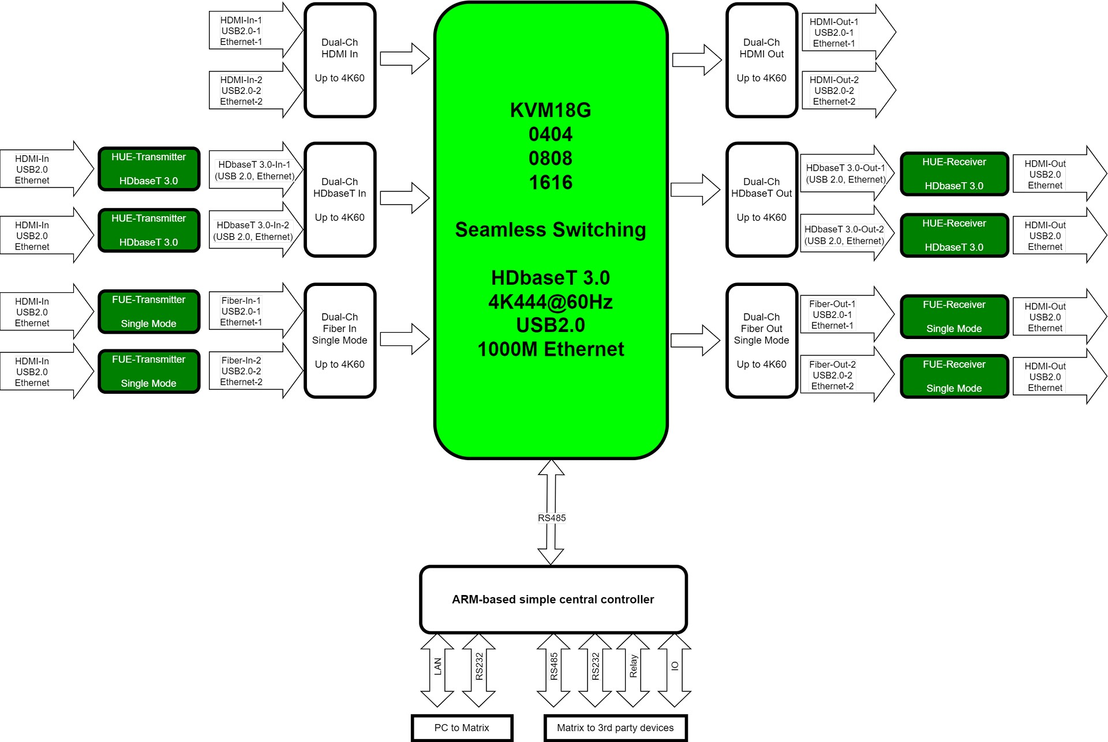
KVM18G，Y2025

Slide 34
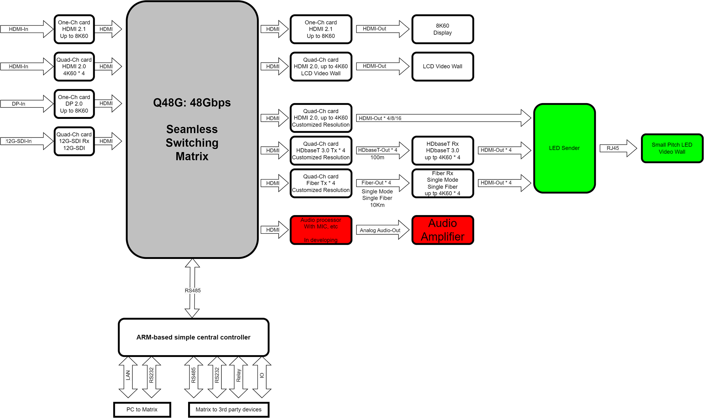
Q48G，Y2025

Slide 35
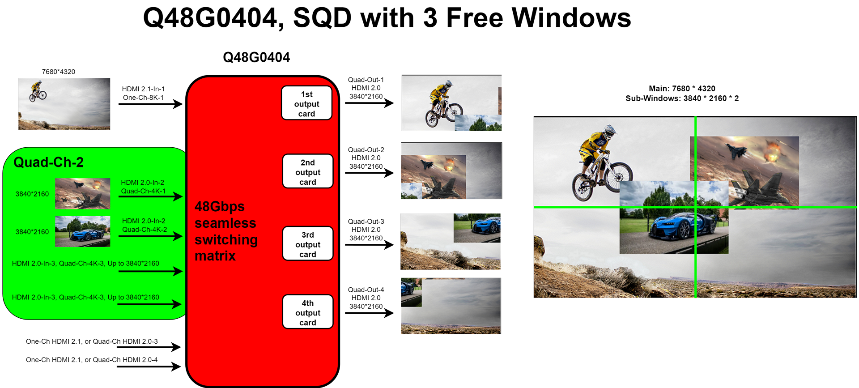
Q48G，Y2025

Slide 36
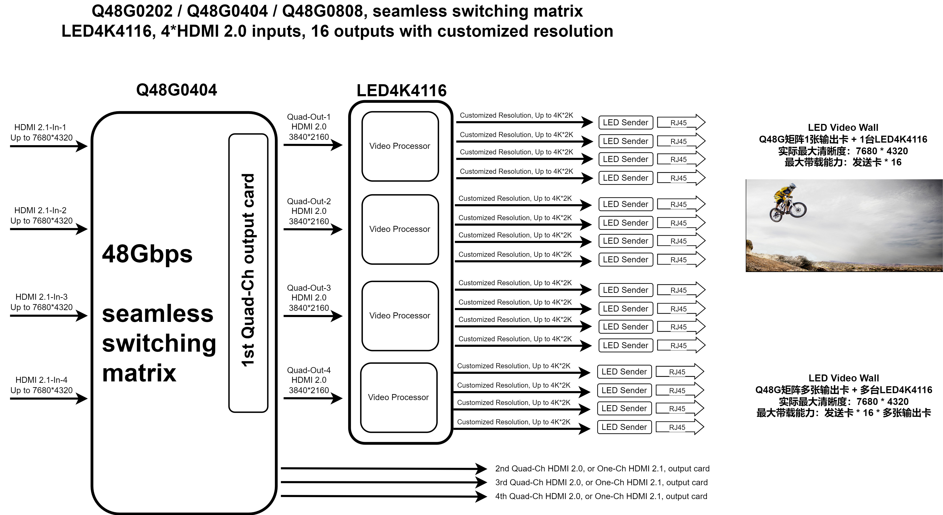
Q48G，Y2025

